Slide 1
West Nile Virus in Chicago
Predictive Analysis of
To Inform Annual Deployment of Pesticides
Team of Arti, Bryan, Jefferson, Nandhini

Slide 2
Agenda
Background
The Data
Modelling
Conclusion

Slide 3
Background
Motivation of analysis
Problem statement

Slide 4
Background
2002
225 cases
22 fatalities
Today
Disease and Treatment agency to strategize and plan
1999
WNV first arrives in US
2001
WNV affects birds in Chicago
2005 Largest outbreak
Notes:
Aim: reduce Culex-breed mosquito populations with the eventual objective of reducing the number of infected mosquitoes.

Slide 5
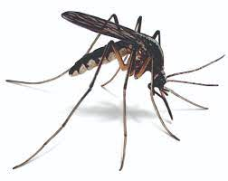
Problem Statement
Utilize available data to predict the probability of WNV-carrying mosquitoes in traps over May to end October of each year.
Determine best time periods and areas to deploy pesticide sprays at.
Cost-Effective methods to prevent breeding of WNV

Slide 6
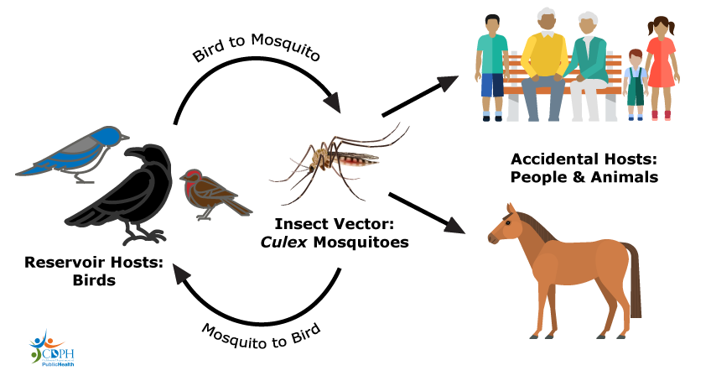
Transmission Cycle

Slide 7
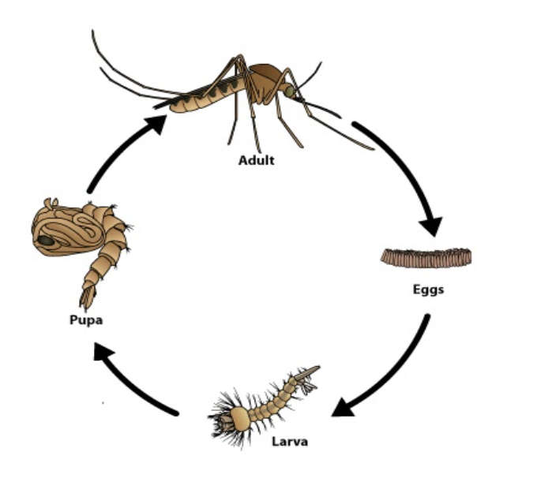
Life Cycle of a Culex Mosquito
Eggs hatch within 2 days.
Larvae develops into pupae in 5 days.
Pupae develops into adult within 2-3 days.
Adult mosquito lifespan is 7-21 days.
Average lifespan: 21 days

Slide 8
The Data
Exploratory Data Analysis
Feature Engineering

Slide 9
Dataset
Mosquito Trap
Weather
Condition
Spray
Effort
2007 - 2014*
2007 - 2014
2011 & 2013
Trap location
Number of Mosquito
WNV presence
Temperature
Humidity
Geographical properties
Spray location
* Only odd years contains Number of Mosquito and WNV Presence

Slide 10
What to Look up for?
Virus Growth Driver
Control Measure
Factor affecting Mosquito Population
Spread pattern
Species effect
Mosquito Season
Past effort effects
Strategies to eliminate virus
Trade-offs

Slide 11
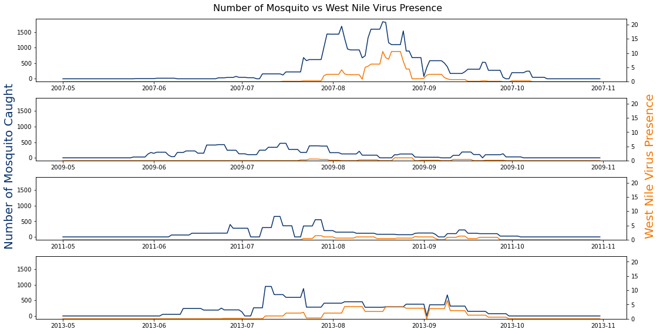
WNV - Number of Mosquitos

Slide 12
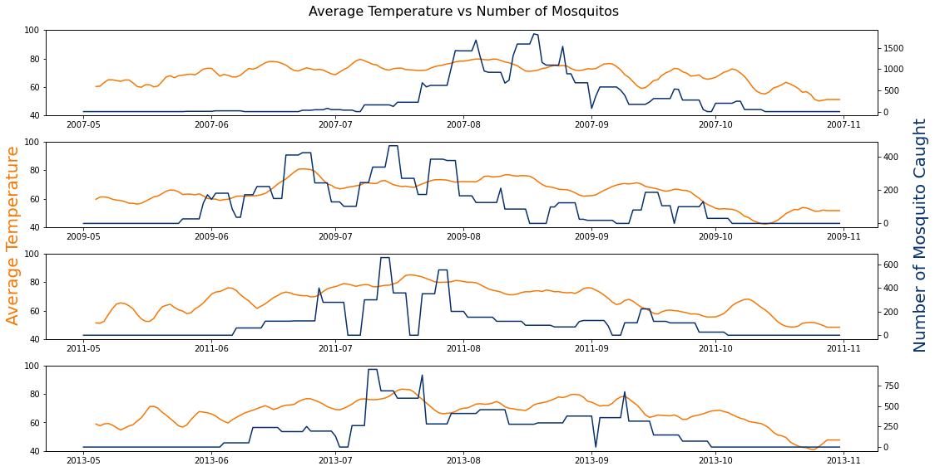
Number of Mosquitos - Temperature

Slide 13
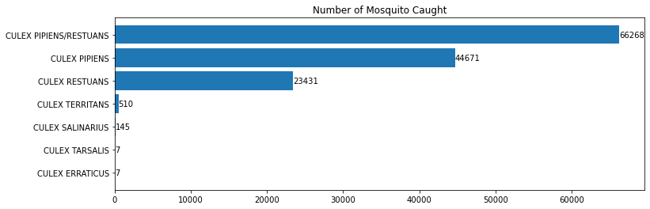
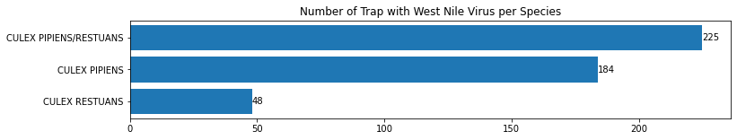
3 Species Carry all the Virus

Slide 14
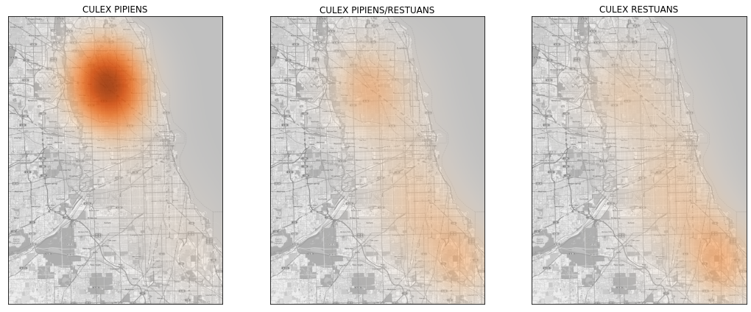
How are the Carrier Species Distributed?

Slide 15
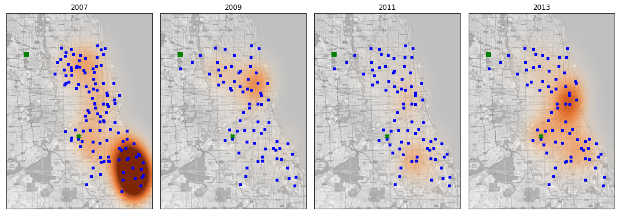
Does Mosquito Appear on the Same Location Yearly ?

Slide 16
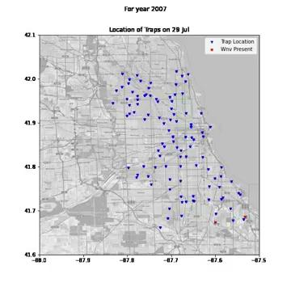
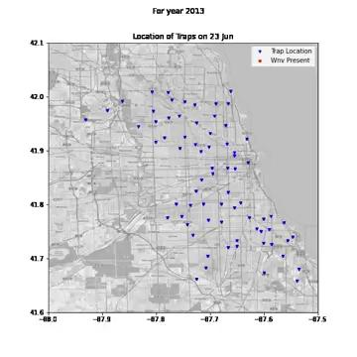
How the Virus Spread?

Slide 17
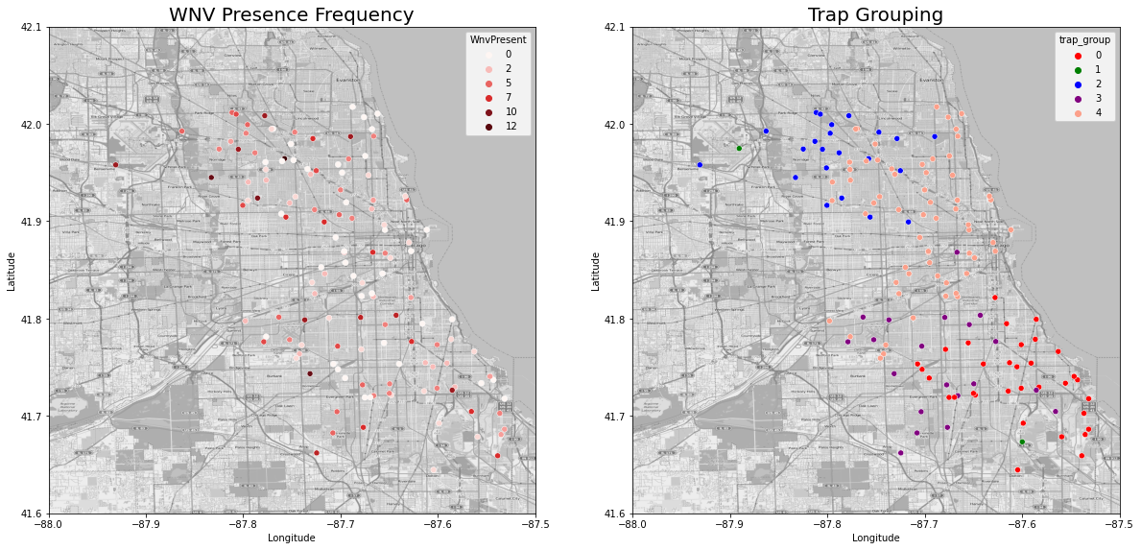
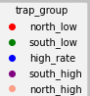
How the Virus Spread?

Slide 18
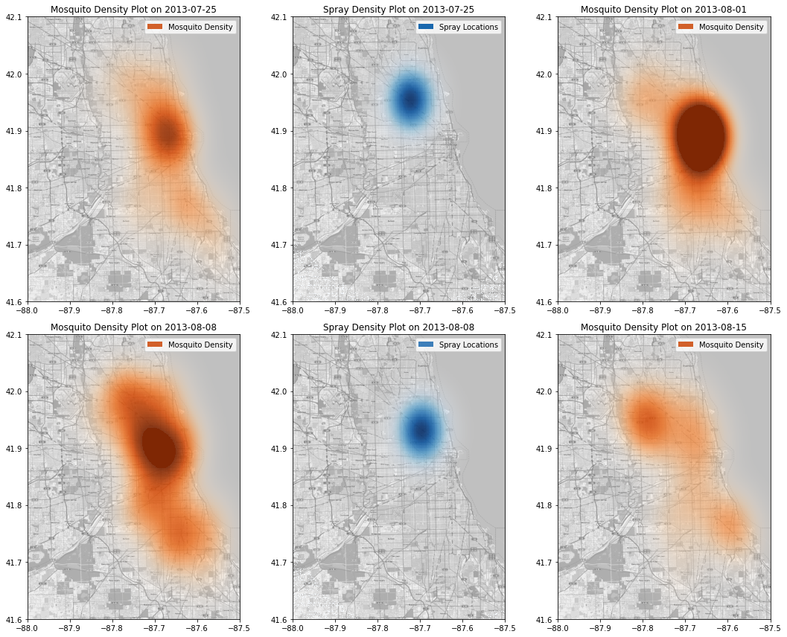
But is spraying effective?
1
2
3
4
5
6

Slide 19
Feature
Engineering
Mosquito Trap
Weather
Condition
2007 - 2014
2007 - 2014
Trap Grouping
K-means, n=5
Infection Rate
Per species for each week of year
Relative Humidity *
Dark hours *
7-days Rolling Average
*https://parasitesandvectors.biomedcentral.com/articles/
**https://www.mosquitomagnet.com/articles/when-are-mosquitoes-most-active

Slide 20
The Model
Model Performance Metric
Imbalance Class Treatment
Model Selection and Trade-off

Slide 21
Model Selection Metrics
False positives Incorrectly predicting the presence of WNV Pros- Increased Sensitivity would result in reducing the virus before spread Cons - Additional spraying cost
False Negatives Incorrectly predicting no WNV Pros - Reduced spray costs Cons - Outbreak of WNV with increase in medical cost, economy cost and human lives
Minimise False Positives while keeping False Negatives = 0

Slide 22
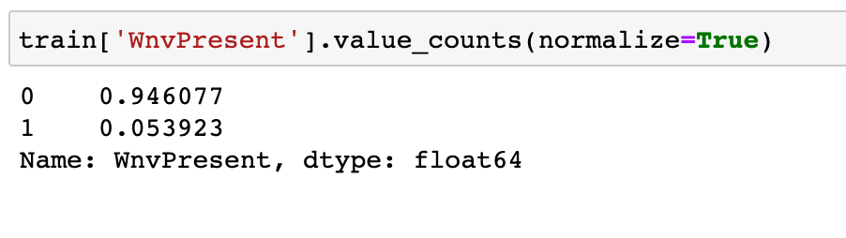
Imbalance Class Treatment
-Imbalanced Classes
-poor performance on the minority class
-Data augmentation of using - SMOTE

Slide 23
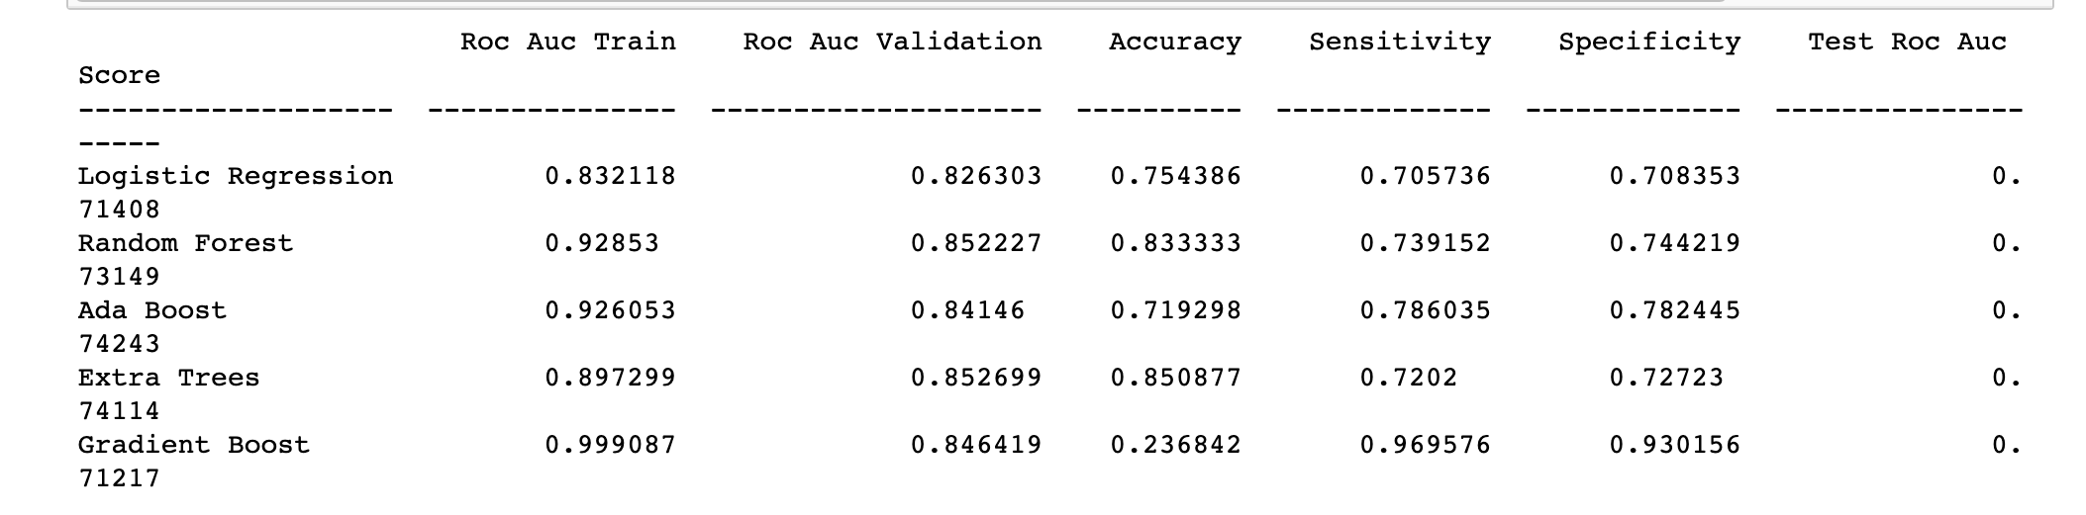
Model Comparison

Slide 24
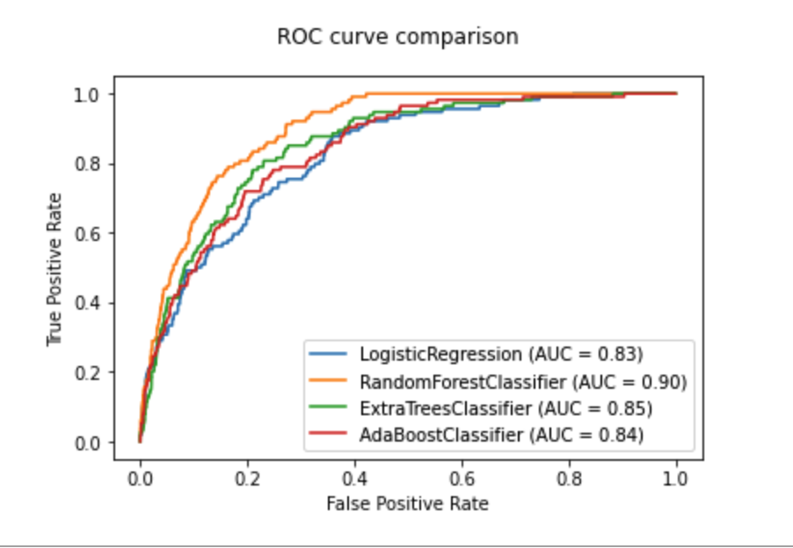
Model Selection
Objective: Minimise False Positives while keeping False Negatives = 0
Higher the AUC, better the model in classifying the data
Random Forest performs better in terms of AUC

Slide 25
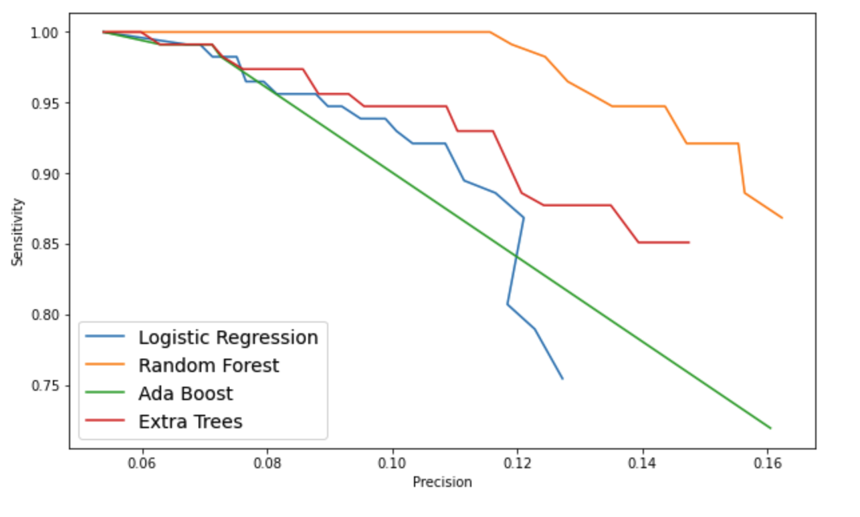
Selecting Best Predictive Model
Sensitivity- Precision plot helps us to identify which model is able to classify all of our positive class well
Reduce False Negatives to 0 while also minimizing False Positives
Random forest has outperformed other models in terms of Precision for most thresholds.
We decided to prioritise Sensitivity over precision as ignoring FN(WNV) might result in outbreak.

Slide 26
Feature Importance
Infection rate consistently the most important
Length of daily dark hours important
Mixed importance for smoothed weather-based features
Model did not find Trap-based features important
Paste feature importance chart on right

Slide 27
Conclusion
What can we infer from the model
Cost Benefit Analysis
Qualitative Analysis

Slide 28
Background on Costs:
 | FALSE NEGATIVES | FALSE POSITIVES
COSTS | Economic costs Businesses close, productivity cost Healthcare costs Medical treatment- as WNV is associated with high healthcare resource utilization | Spraying cost Emergency control spray Overtime hours Costs of pesticide spray Environment cost Affects wildlife, wild honeybees(can be avoided by spraying at night and moving hives, cover with wetted burlap)

Slide 29
Case Study
California | Medical cost | Vector cost | Economic cost
2005 | 2.28 million | $710790 | 2.78 million

Slide 30
Recommendations: Improving Model
Number of Mosquitoes in the mosquito season are likely affected by weather conditions before May per year.
Attempt to classify trap areas by:
Geographic data: Distance to water-type infrastructure like large drains, or near water-based geographic water features like ponds.
Demographic data: Types of surrounding homes, income level

Slide 31
Recommendations: Usage of Predictive Model in distribution of budget for pesticide sprays
For a given week, highest probability trap areas will be handled with priority as far as budget can go.

Slide 32
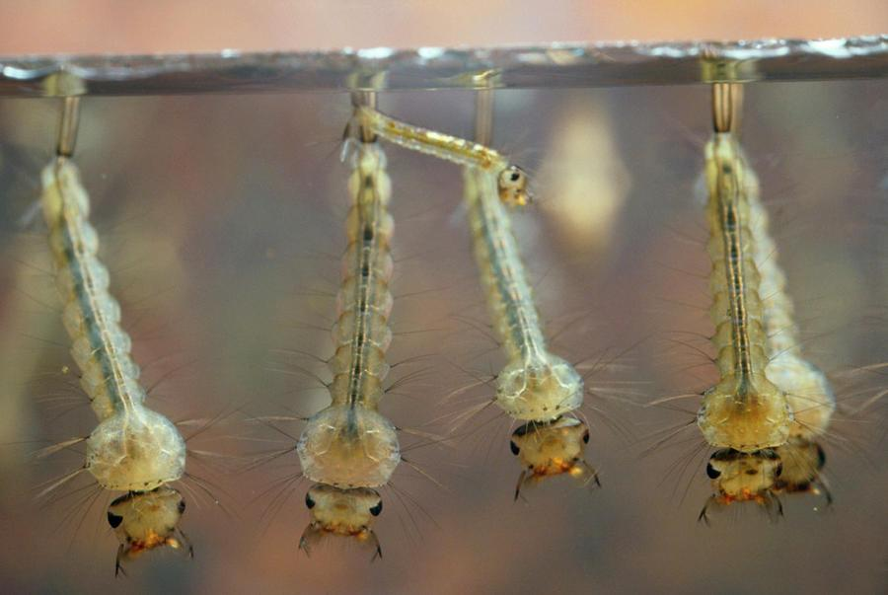
Recommendations
Early intervention will result in fewer mosquitoes in subsequent weeks, fewer mosquito infections, and finally fewer human infections.

Slide 33
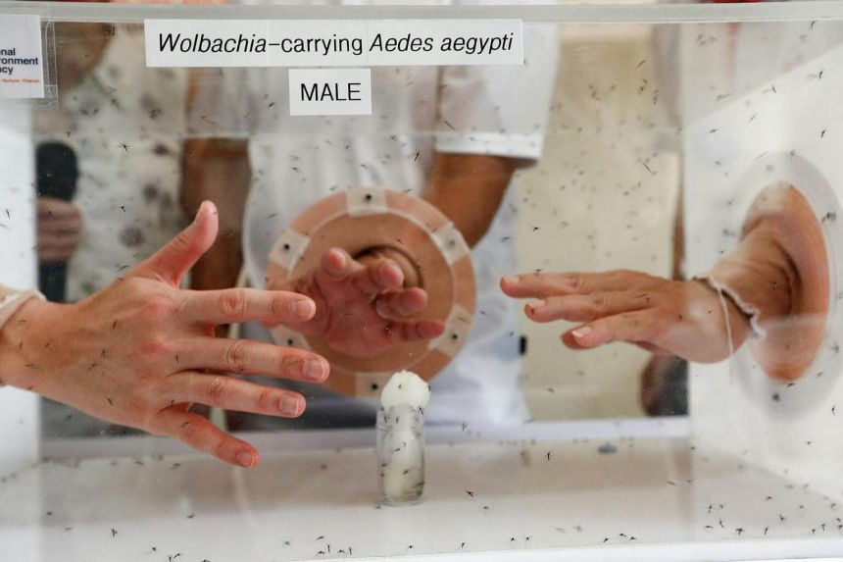
Recommendations
Can adopt measures from Singapore to combat mosquito-borne viruses - ground checks of homes and premises for mosquito habitats, impose penalties if found mosquito breeding.

Slide 34
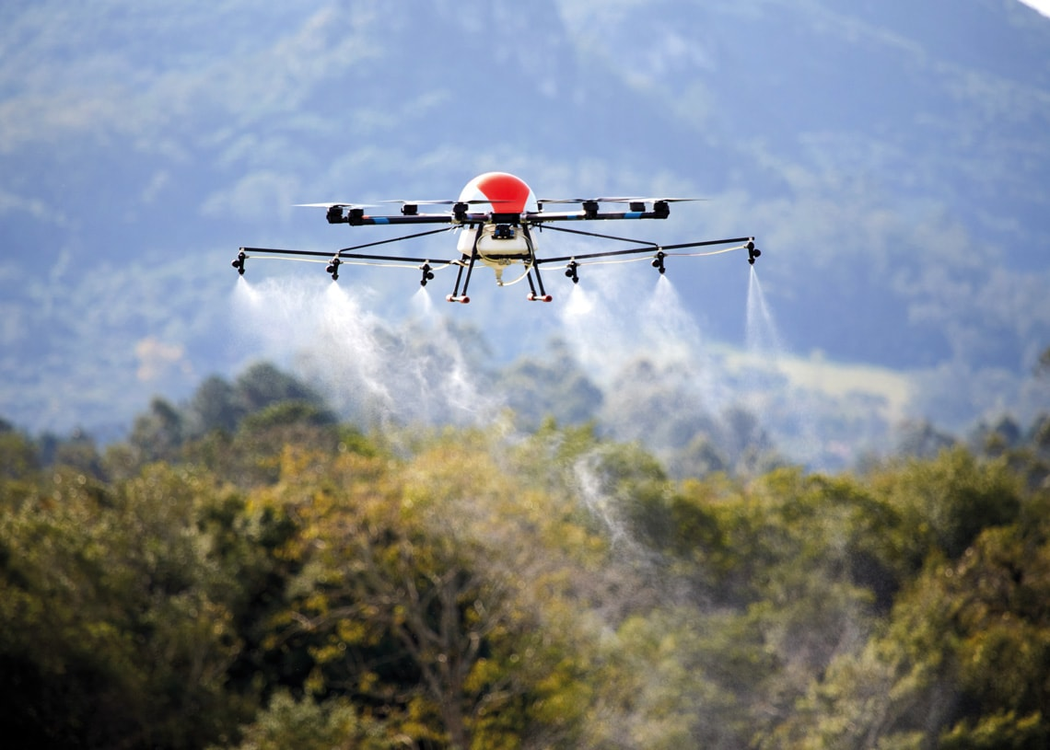
Recommendations
Aerial spray through drones - targeting larval habitats- better than truck, airplanes and helicopters.

Slide 35
Conclusion
Seasonal nature of data allowed for prediction of WNV mosquito infections in test data.
Predictions from model allow for timely identification of highest risk areas for pesticide spraying

Slide 36
Thank you!

